Slide 1
Statistics &
Probablities
By Sriram

Slide 2
Descriptive Statistics
Agenda –
In this session you will learn about
Basics of Statistics
Types of Variables
Measure of Central Tendancy
Measure of Dispersion
Case studies of Central tendencies and Dispersion
Percentile/Quartile & Correlation and Covariance
Central Limit Theorem
Data Visualization and distribution

Slide 3
What is Statistics ?

Slide 4
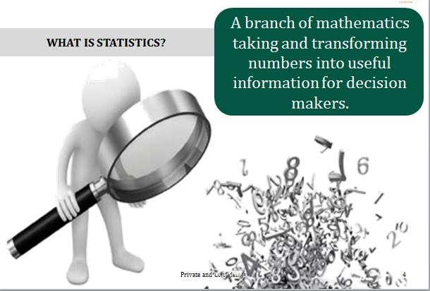

Slide 5
What is Statistics

Slide 6
Why Learn Statistics ?

Slide 7
Case 1 - Answer in 5 seconds !

Slide 8
Case 1 - Answer in 5 seconds !
A college in US has students from the following countries for a Masters degree. Which country is in majority ?

Slide 9
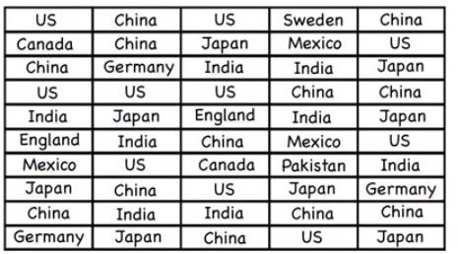
Case 1 - Answer in 5 seconds !
A college in US has students from the following countries.
Which country is in majority ?

Slide 10
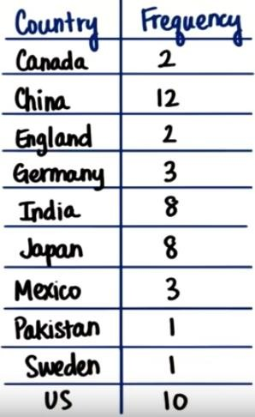
Frequency Table

Slide 11
Case 2
Problem
A parent changes school of their Son who is studying in 11th standard since his academic results are not good in 10th Standard in his current School.
They change Student A from ABC school to XYZ school

Slide 12
Case 2
Problem
A parent changes school of their Son who is studying in 11th standard since his academic results are not good in 10th Standard in his current School.
They change Student A from ABC school to XYZ school
Results
Ranked 15th in ABC school
Ranked 2nd in XYZ school
What’s the conclusion ?

Slide 13
Case 2
Problem
A parent changes school of their Son who is studying in 11th standard since his academic results are not good in 10th Standard in his current School.
They change Student A from ABC school to XYZ school
Results
Ranked 15th in ABC school
Ranked 2nd in XYZ school
What’s the conclusion: Has the student improved ?

Slide 14
Number of Students
No of Students in ABC School
No of Students in XYZ School
60
35
30
25
20
15
10
5
0
50
40
30
20
10
0
Class 10
Class 11
Class 12
Class 10
Class 11
Class 12

Slide 15
Why Learn Statistics ?

Slide 16
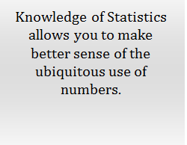
Why Learn Statistics ?

Slide 17
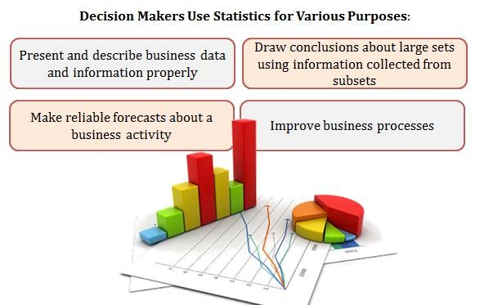
Why Learn Statistics ?

Slide 18
Statistics is …
Collecting Data
Analyzing Data
Interpreting Data
Presenting Data

Slide 19
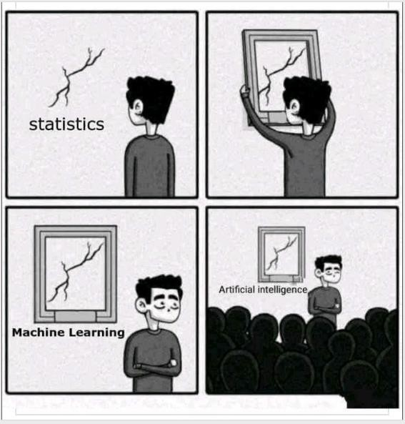
What does it Tell ?

Slide 20
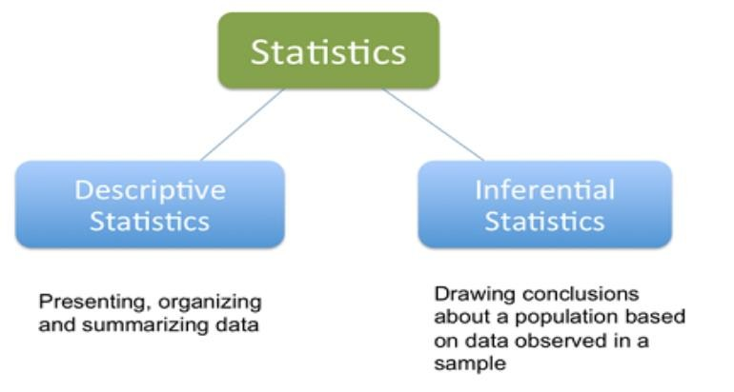
Classification

Slide 21
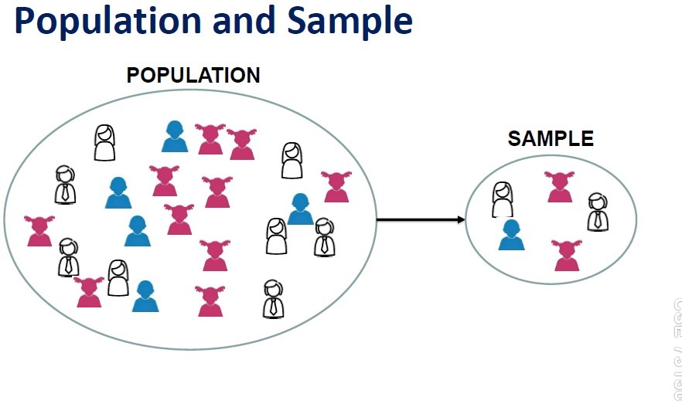

Slide 22
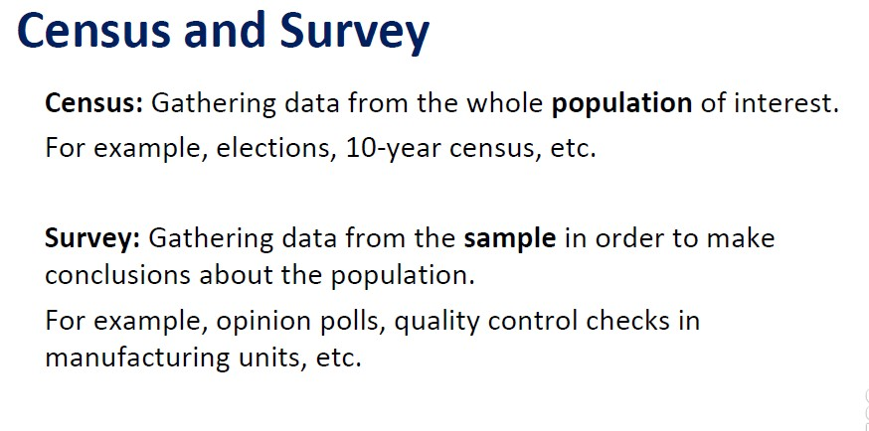

Slide 23
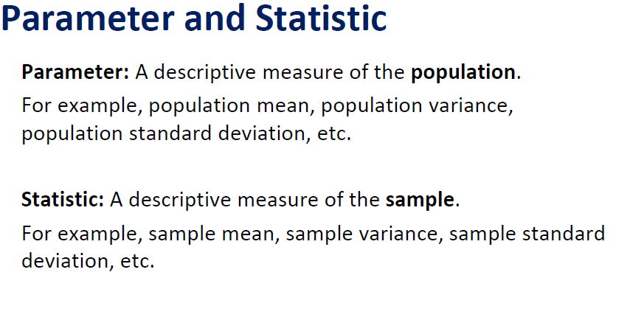

Slide 24
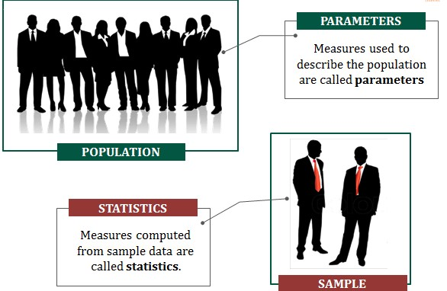

Slide 25
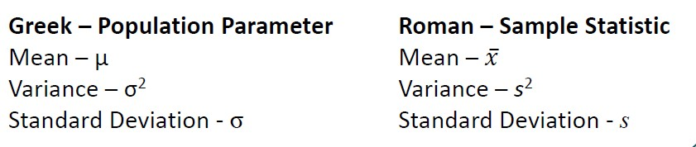
Statistical Notations

Slide 26
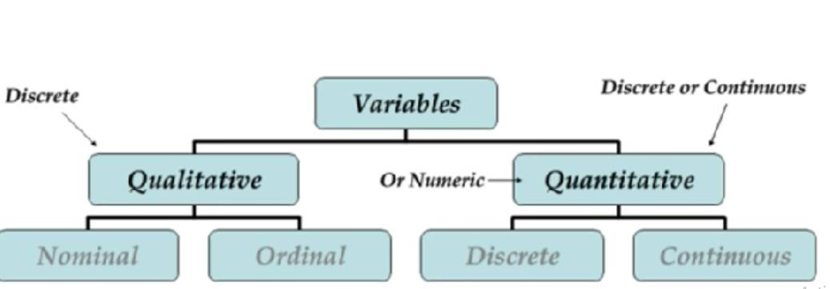
Variables

Slide 27
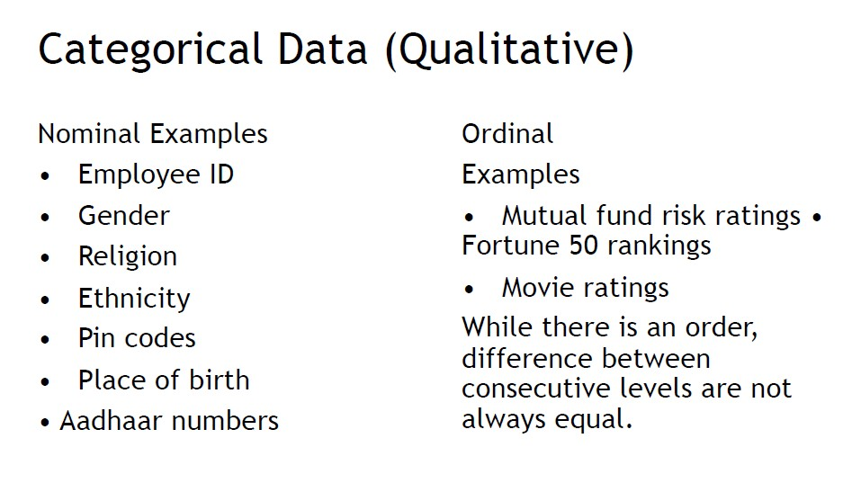

Slide 28
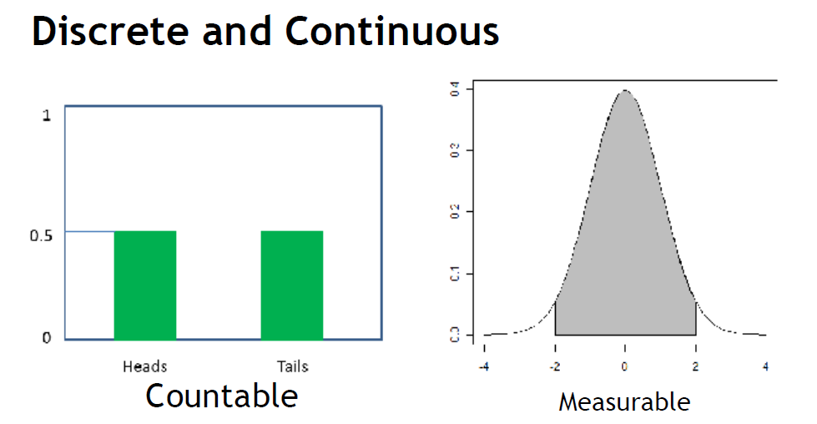

Slide 29
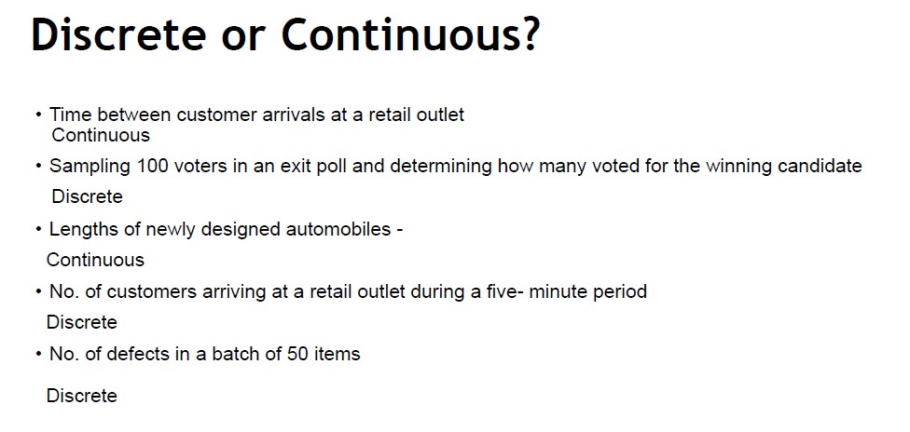

Slide 30
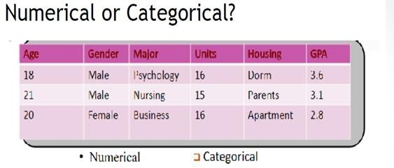

Slide 31
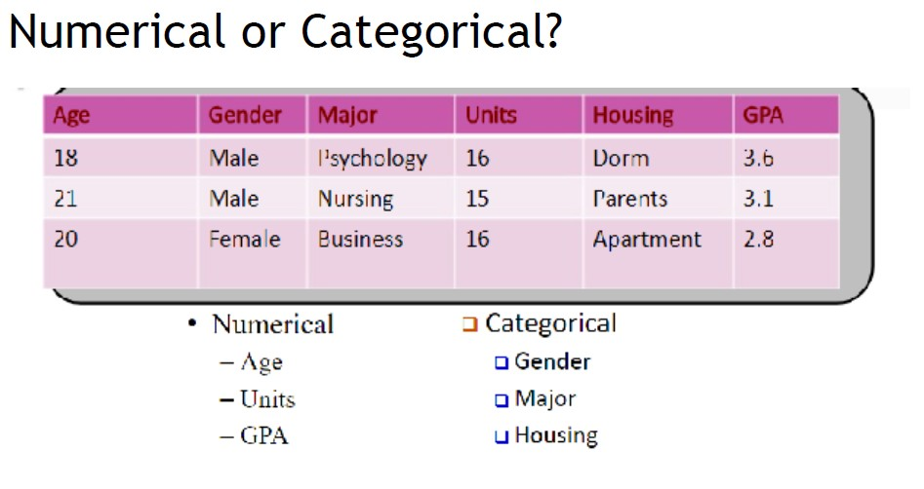

Slide 32
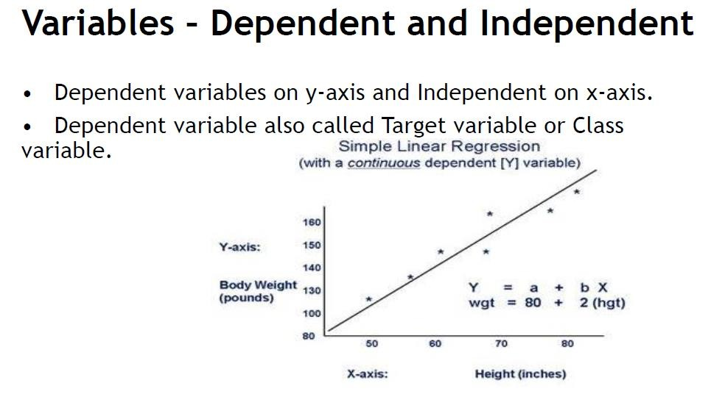

Slide 33
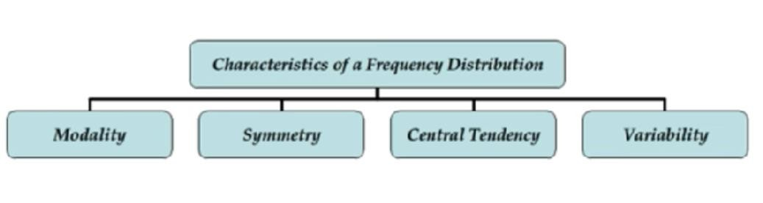
Summarizing Data

Slide 34
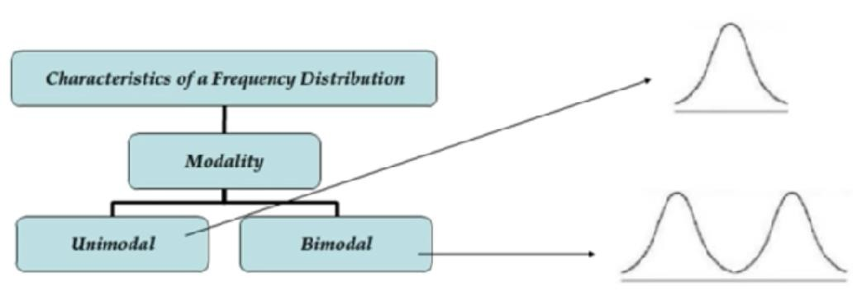
Modality

Slide 35
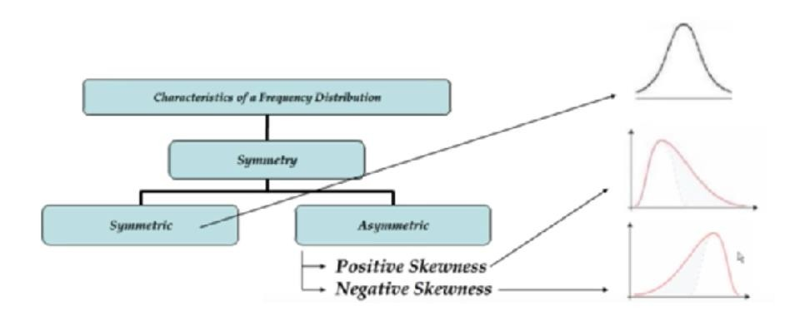
Symmetry

Slide 36
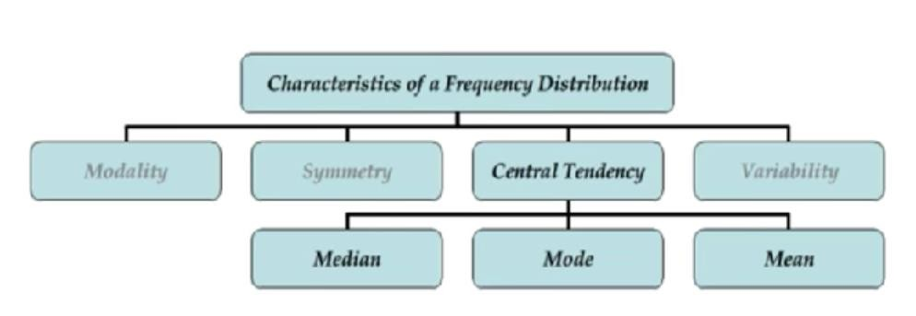
Central Tendency

Slide 37
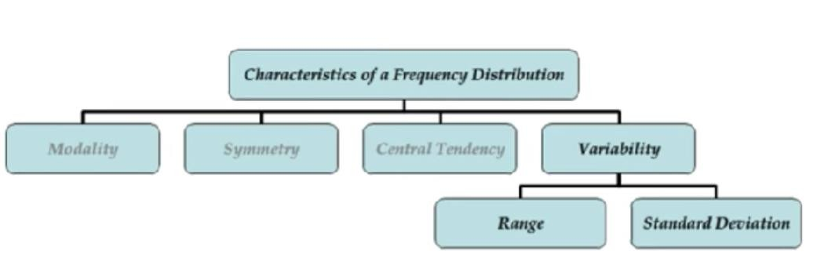
Variability

Slide 38

- The reliable quantity

Slide 39

Mean

Slide 40
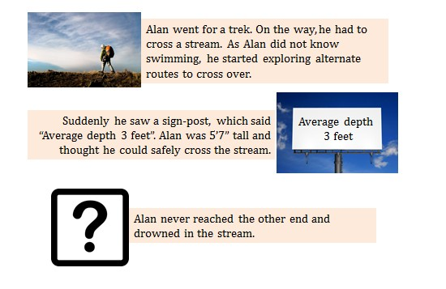

Slide 42
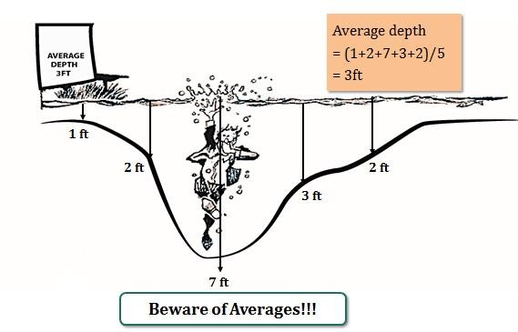

Slide 43
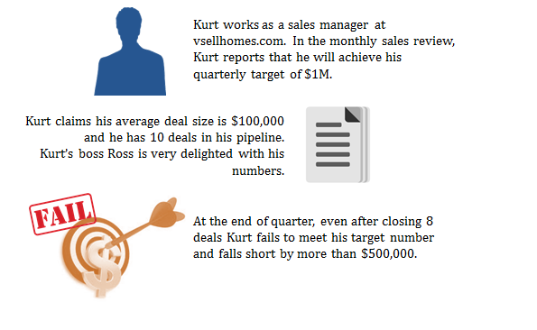

Slide 44
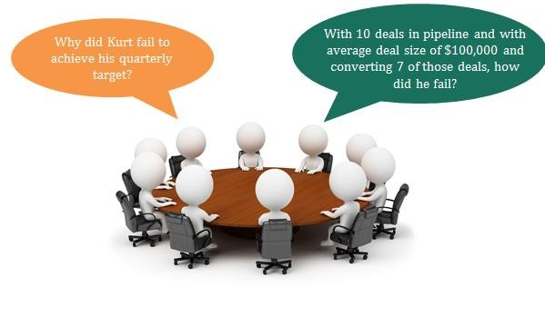

Slide 45

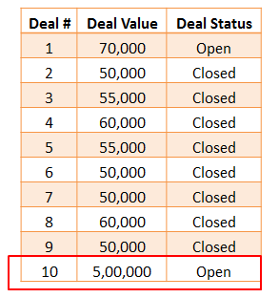

Slide 46


Slide 47
Median

Slide 48
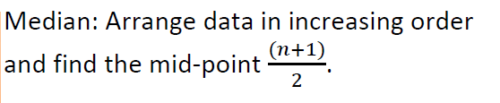
Median

Slide 49


Slide 50


Slide 51
Mode

Slide 52
Mode

Slide 53
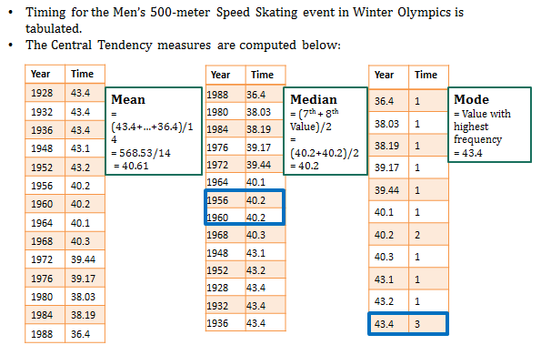

Slide 54
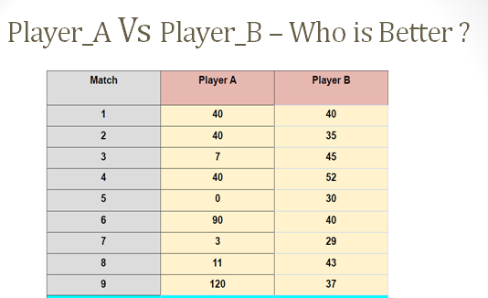

Slide 55
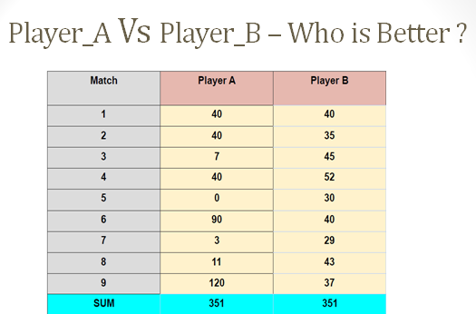

Slide 56

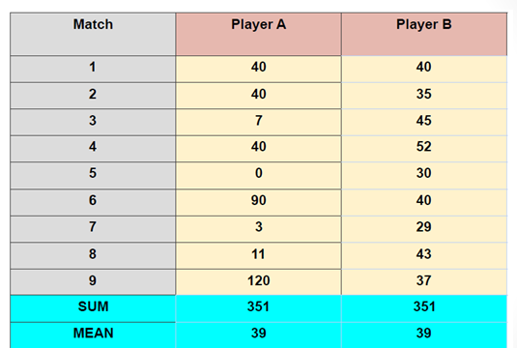

Slide 57
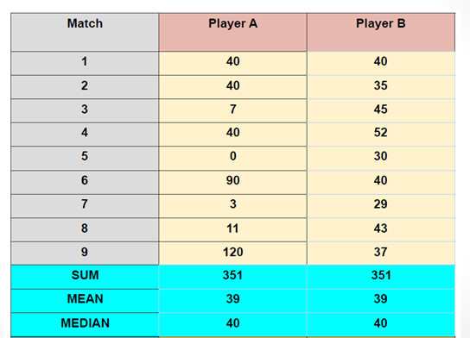

Slide 58
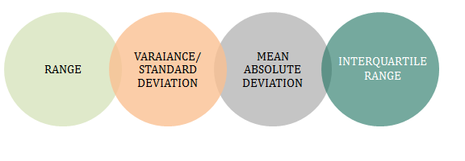

Slide 59

Spread of Data - Range

Slide 60


Spread of Data - SD and Variance

Slide 61
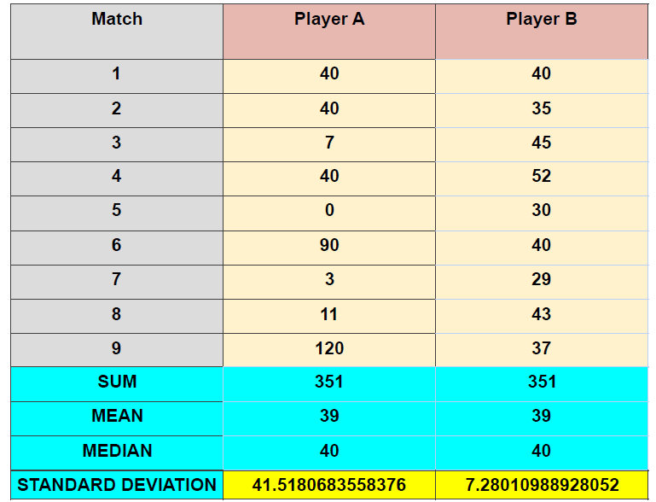
Who’s Best ?

Slide 62
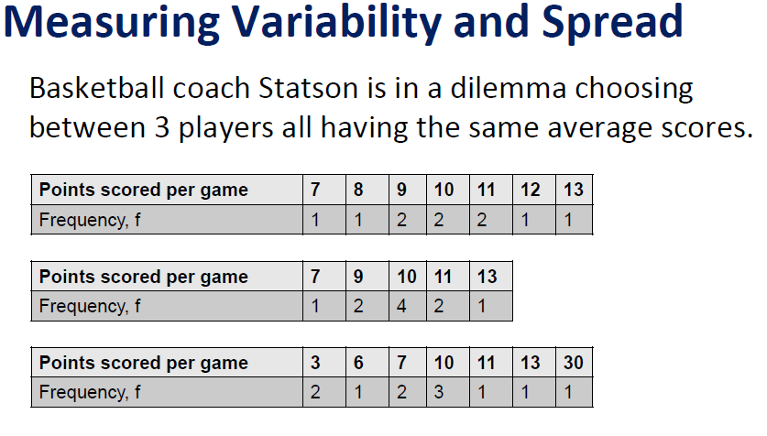

Slide 63
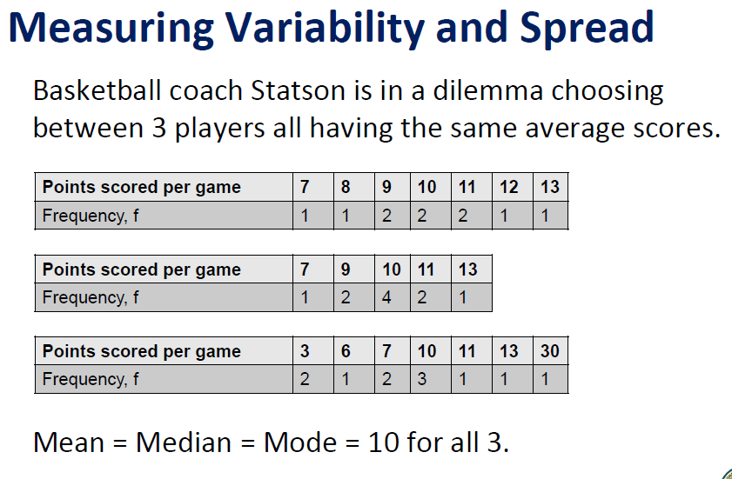

Slide 64
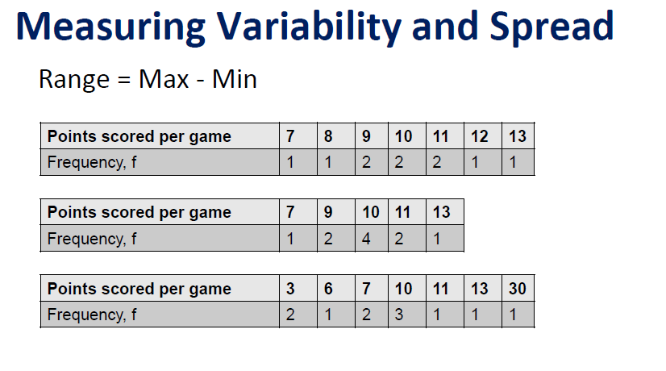

Slide 65
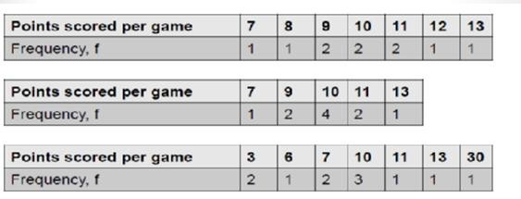

Slide 66
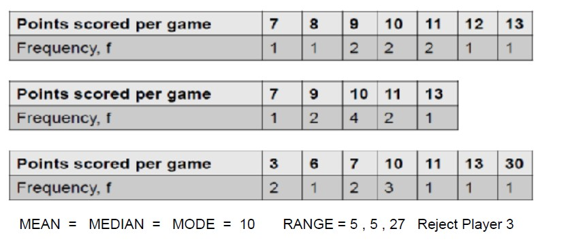

Slide 67
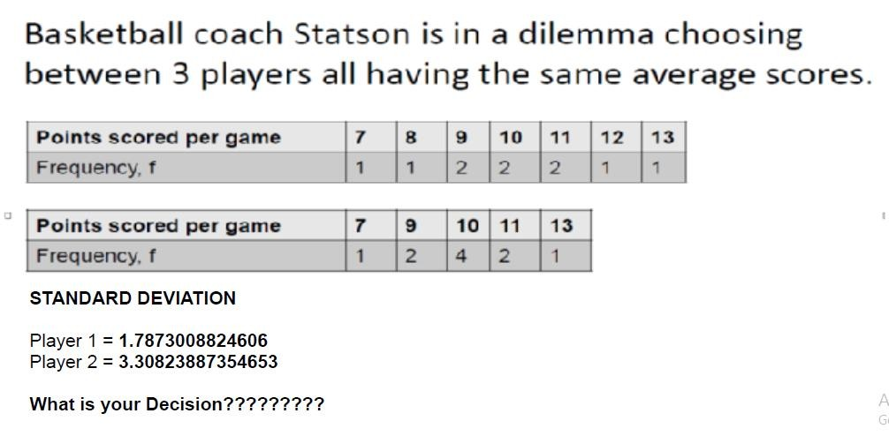

Slide 68
Percentile & Quartile
Nth percentile states that there are atleast N% of values less than or equal to this value and (100-N) values are greater or equal to this value
i = (N/100)*n
N – The percentile you are interested
n – Number of values
Key points
If i is decimal then round off to next value
If i is integer then take average of i and i+1 value

Slide 69
Let’s calculate 85th percentile
Data:
3310 3355 3450 3480 3480 3490 3520 3540 3550 3650 3730
3925
Calculate 85th percentile ?

Slide 70
Quartile
Data:
3310 3355 3450 3480 3480 3490 3520 3540 3550 3650 3730
3925
Quartile
Dividing data into ¼ – 4 parts
Q1 – First Quartile – 25th percentile
Q2 – Second Quartile – 50th percentile (Median) Q3 – Third Quartile – 75th percentile
IQR (Inter Quartile Range) = Q3 – Q1

Slide 71
Inter Quartile Range
Quartile
Dividing data into ¼ – 4 parts
Q1 – First Quartile – 25th percentile
Q2 – Second Quartile – 50th percentile (Median) Q3 – Third Quartile – 75th percentile
IQR (Inter Quartile Range) = Q3 – Q1

Slide 72
Case Study
In an Under 19 World Cup selection squad for 2018 the BCCI needs to select 1 player based on the current performance in 2017 – 2018 Ranji Trophy. There are 2 players with similar stats and the board is not sure whom to select.
- Can you help the board members with your analysis ?

Slide 73
Stats - Player X & Y
Runs scored by both players in
last 14 matches
Player X | Player Y
40 | 35
20 | 40
5 | 7
20 | 23
10 | 20
75 | 26
100 | 12
25 | 30
15 | 27
15 | 102
20 | 18
17 | 17
11 | 14
5 | 7

Slide 74
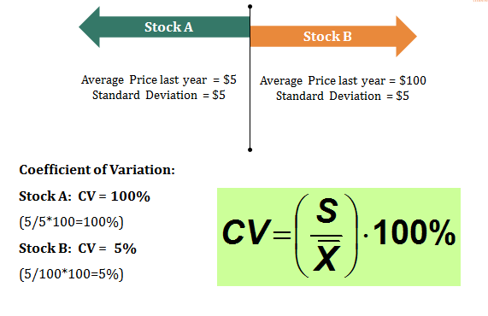
Coefficient of Variation
Coeff of Variation = (Standard deviation/ Mean) * 100 %

Slide 75
Coefficient of Variation
Calculate the descriptive statistics of both players and if the
coefficient of variation is greater than 85% then drop that player
Coeff of Variation = (Standard deviation/ Mean) * 100 %

Slide 76
Measures of association between 2 variables
Covariance
Correlation coefficient

Slide 77
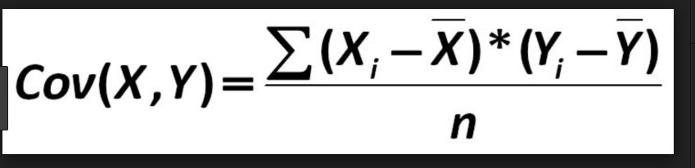
Covariance
Higher the value stronger the relation between them

Slide 78
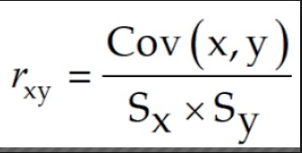
Correlation coefficient
Key Points
A measure of relationship not affected by the units of measurements
Ranges from -1 to +1

Slide 79
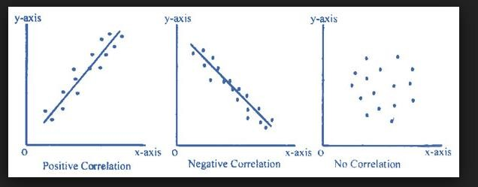
Types of Correlation

Slide 80

Central Limit Theorem
When samples of size n>=30 are drawn from a population and distributed with individual samples mean then any distribution changes to normal distribution

Slide 81
Key Points
Also called as Standard Error (SE)
Standard deviation of sample mean = (population standard deviation/square root(n))
Mean of sample means distribution = Population mean
NOTE: As n increases SE decreases - SE is inversely proportional
to n

Slide 82
Data Visualization - Plots
Box Plot
Scatter plot
Density Plot

Slide 83
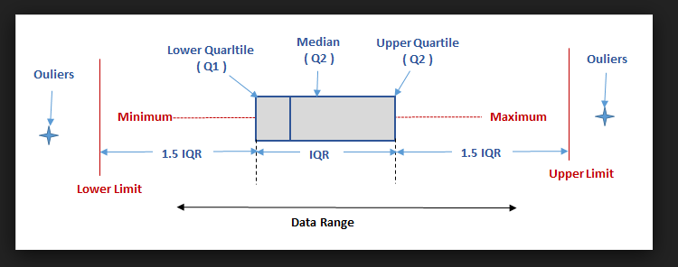
Box Plot - Shows the data spread for individual columns

Slide 84
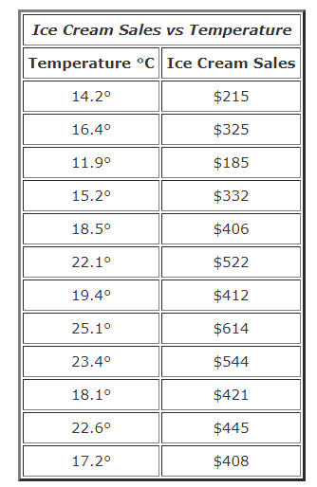
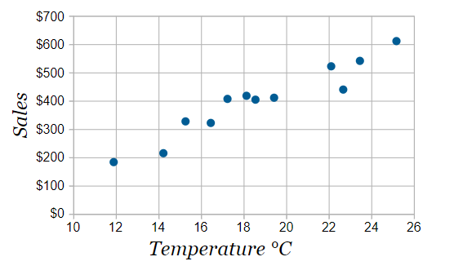
Scatter Plot - Shows relationship between 2 columns

Slide 85

Density Plot - Shows the distribution of data

Slide 86
Statistical simulation link
http://www.shodor.org/interactivate/activities/

